Slide 1

Dr.Mahalingam College of Engineering & Technology
Department of Artificial Intelligence & Data Science
Team Number : B-10
Domain : Artificial Intelligence
Title : AI Cyber Investigation Assistant
Faculty Supervisor : Ms. M. Rajalakshmi, AP(SS) /AI&DS
Team Members : Dhaksinesh sai G
Jaidev A J
Kirthick S

Slide 2
AGENDA
_____________________________________
Introduction
Problem Statement
Objectives
Proposed Methodology
Applications
Technology Stack
Initial Frontend Development
Expected Outcome
Case Study
Conclusion
References
__________________________________________________________

Slide 3
INTRODUCTION
What is AI Digital Evidence Analyzer?
An AI-powered digital forensics system.
Automatically analyzes digital evidence files.
Uses OCR, NLP and Large Language Models (LLMs).
Extracts important entities and summarizes evidence.
Assists investigators in cybercrime investigations.

Slide 4
PROBLEM STATEMENT
Manual analysis of digital evidence is time-consuming.
Large volumes of files make investigations difficult.
Important evidence can be overlooked by investigators.
Existing forensic tools extract data but lack intelligent analysis.
Need an AI-powered system for faster and accurate evidence investigation.

Slide 5
OBJECTIVES
________________________________________
Extract information from digital evidence files.
Identify names, dates, phone numbers, and email addresses.
Summarize conversations using AI.
Generate investigation timelines automatically.
Produce a detailed AI-powered investigation report.

Slide 6
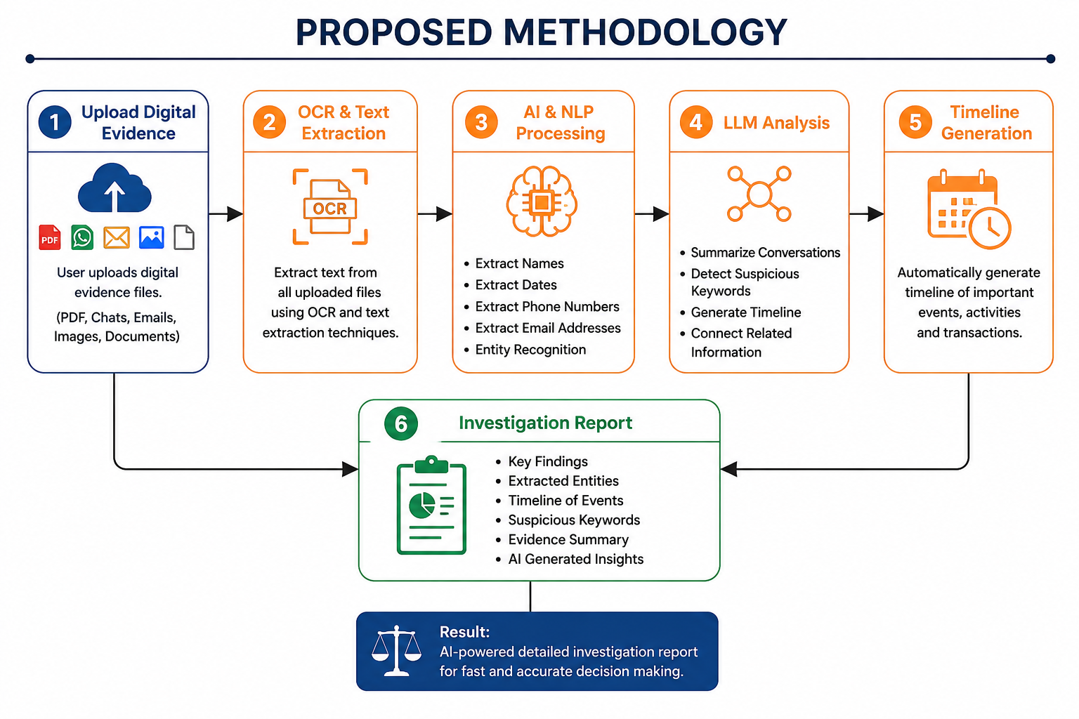

Slide 7
APPLICATIONS
________________________________________
Cybercrime Investigation
Analyze digital evidence from cybercrime cases
Law Enforcement
Assist police and investigation agencies
Digital Forensics
Process and analyze seized digital devices
Financial Fraud Detection
Detect suspicious transactions and fraud
Corporate Security
Investigate insider threats and security incidents

Slide 8
TECHNOLOGY STACK
_____________________________________
Frontend
React.js
Backend
Python (FastAPI)
AI & NLP
OpenAI GPT, spaCy
OCR
Tesseract OCR
Database
MongoDB

Slide 9
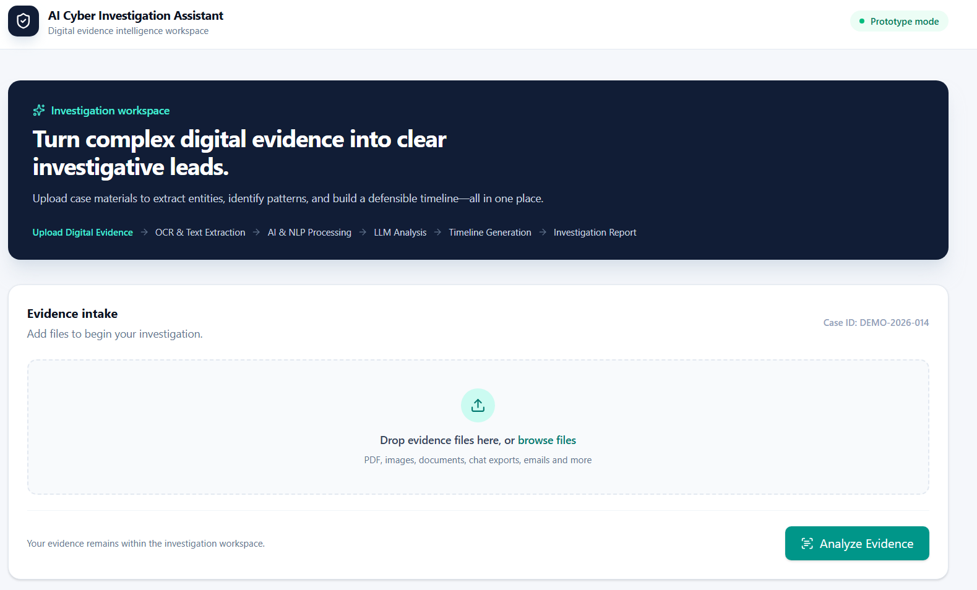
Initial Frontend Implementation
_____________________________________
Developed the AI Cyber Investigation Assistant web interface.
Added digital evidence upload functionality.
Designed the investigation workflow and dashboard.
Added sample analysis results for demonstration.
Built using React.js, Vite, TypeScript & Tailwind CSS.

Slide 10
EXPECTED OUTPUT
________________________________________
Faster digital evidence analysis.
Automatic extraction of key entities.
AI-generated evidence summary.
Investigation timeline generation.
Detection of suspicious keywords.
Comprehensive investigation report.

Slide 11
CASE STUDY
User uploads digital evidence files.
Evidence includes PDFs, emails, chats, and images.
OCR extracts text from scanned documents.
AI identifies names, dates, phone numbers, and emails.
LLM summarizes conversations and documents.
Suspicious keywords are detected automatically.
Investigation timeline is generated.
AI produces a complete investigation report.

Slide 12
CONCLUSION
_____________________________________
AI improves digital evidence analysis.
Reduces manual investigation effort.
Extracts key information accurately.
Generates investigation timelines automatically.
Summarizes digital evidence efficiently.
Supports faster and smarter cybercrime investigations.

Slide 13
REFERENCES
_____________________________________
Rafael C. Gonzalez and Richard E. Woods. Digital Image Processing. Pearson Education, 2018.
Matthew Honnibal and Ines Montani. spaCy: Industrial-Strength Natural Language Processing in Python. Explosion AI, 2023.
Tom B. Brown, Benjamin Mann, Nick Ryder, et al. Language Models are Few-Shot Learners. Advances in Neural Information Processing Systems (NeurIPS), 2020.

Slide 14
THANK YOU

